Slide 1
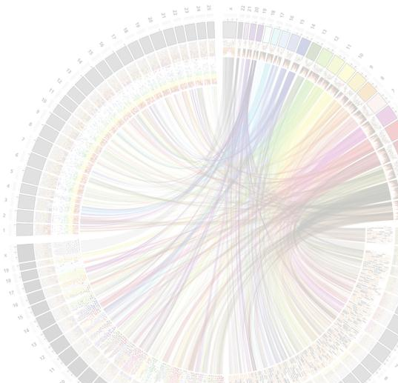


MSc in Bioinformatics
Module 4
Python programming for Structural Biology
Jean-Didier Maréchal and Jaime Rodríguez Guerra
The Biotechnological Computational Chemistry Team
Department of Chemistry (UAB)
Course 2015-16

Slide 2
Introduction
What is python
Bla bla

Slide 3
Why using python in Structural Biology?
Multiple Advantages:

Slide 4
Python embedding in Biomolecular suites

Slide 5
Basics in coding
High level syntax
i.e.

Slide 6
Hands on:
Hello world

Slide 7
Python embedded Biomolecular platforms
Behind most visualizing programs:
Pymol
Chimera
Etc.

Slide 8
UCSF Chimera and python
Basics:
How to reach the python layer into ucsf Chimera
IDLE
Imagenes

Slide 9
Hello world inside Chimera

Slide 10
Structural objets in chimera
Model
Atoms
Residues
Bonds

Slide 11
My first structural scripts
1. Reaching modes
2. Reaching selections
Atoms
Residues

Slide 12
command line and scripting
How to use command lines:
Examples

Slide 13
Bridging command line and scripting
Embedding a command line in a python run is performed using:

Slide 14
Script 1
Printing the sequence of amino acids

Slide 15
Script 2
Show and display with a different color residues in a binding site pocket

Slide 16
Script 3
Printing the list of serial numbers of a selection
Print list of only polar residues

Slide 17
Script 4: oneliners

Slide 18
Guiding modeling thoughout python (a small but kind of complex script)
rotameros

